Slide 1
House Prices
Advanced Regression Techniques
Team 3
Richard Loftis, Yuqian Liu,
Addie Puskar, Cam Spangler

Slide 2

TABLE OF CONTENTS
01
02
03
04
Overview of Competition
Critique of Select Notebook
Solution Code
Solution Code Reproducibility

Slide 3
Overview of Competition
This dataset proves much more influences price negotiations than the basic idea of number of bedrooms and baths
Data includes 79 explanatory variables describing almost every aspect of residential homes in Ames, Iowa
Problem Statement: To predict the final sale price of each house. It is evaluated by the RMSE between the predicted value and logarithm of the observed sales price.
House Prices - Advanced Regression Techniques | Kaggle
Notes:
Taking logs means that errors in predicting expensive houses and cheap houses will affect the result equally.

Slide 4
Critique of Select Notebook
Basic linear regression - Home Prices from CSV | Kaggle
Limited data exploration
Lack of feature engineering
Use of linear regression without considering assumptions
Notes:
Based critique using How to avoid machine learning pitfalls: a guide for academic researchers
the RMSE function is defined as a custom function to calculate the Root Mean Squared Error between the predicted and actual values. The function takes two arguments x and y, which are the predicted and actual values, respectively. The function first takes the natural logarithm of both the predicted and actual values, then calculates the squared difference between them, takes the sum of those squared differences, divides by the length of the dataset, and finally takes the square root of the result. This is the formula for the RMSE metric.
Limited data exploration: The code only provides summary statistics and a few head observations to explore the data. More thorough data exploration can help identify any issues with the data and suggest additional features to include in the model.
Lack of feature engineering: The code does not perform any feature engineering, which can be an important step in building a predictive model. Feature engineering involves transforming or combining existing features to create new features that can improve model performance.
Use of linear regression without considering assumptions: The code uses linear regression without checking or addressing the assumptions of the model, such as normality of residuals, constant variance, and independence of errors. Failing to address these assumptions can lead to biased or unreliable results.

Slide 5
Solution Code

Slide 6
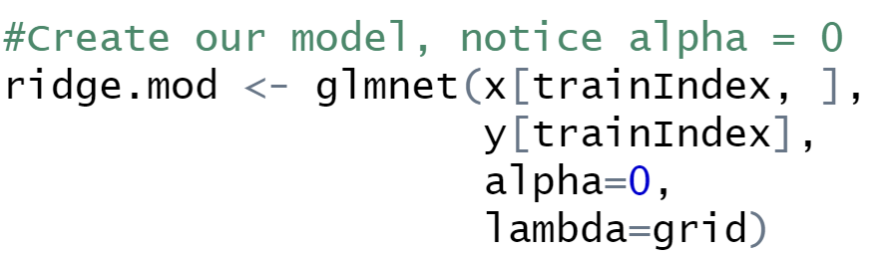
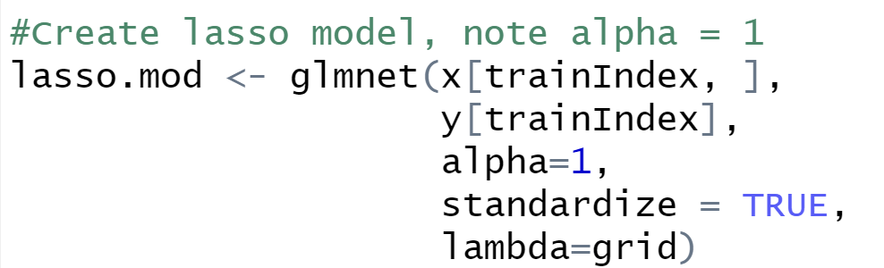
Reproducibility of Solution Code
Do try out a range of different models
Ridge, lasso, bag, boosted, XGBoost
Don’t use inappropriate models
All the models are applicable to predict a numeric output

Slide 7
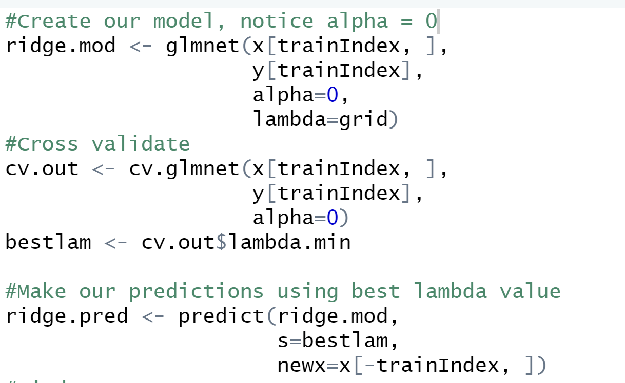
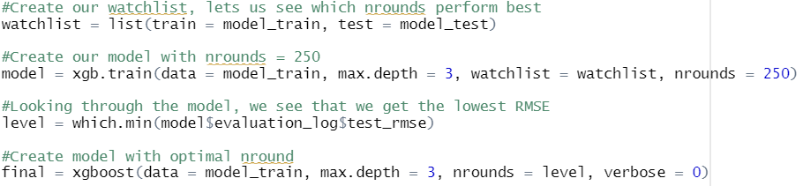
Reproducibility of Solution Code
Do optimize your model’s hyperparameters
-------------------------------------------------------------------------------------------------------

Slide 8
Reproducibility of Solution Code
Do be careful where you optimize hyperparameters and select features
Optimizing hyperparameters for XGBoosting model
Performed features selection by lasso and ridge regression

Slide 9
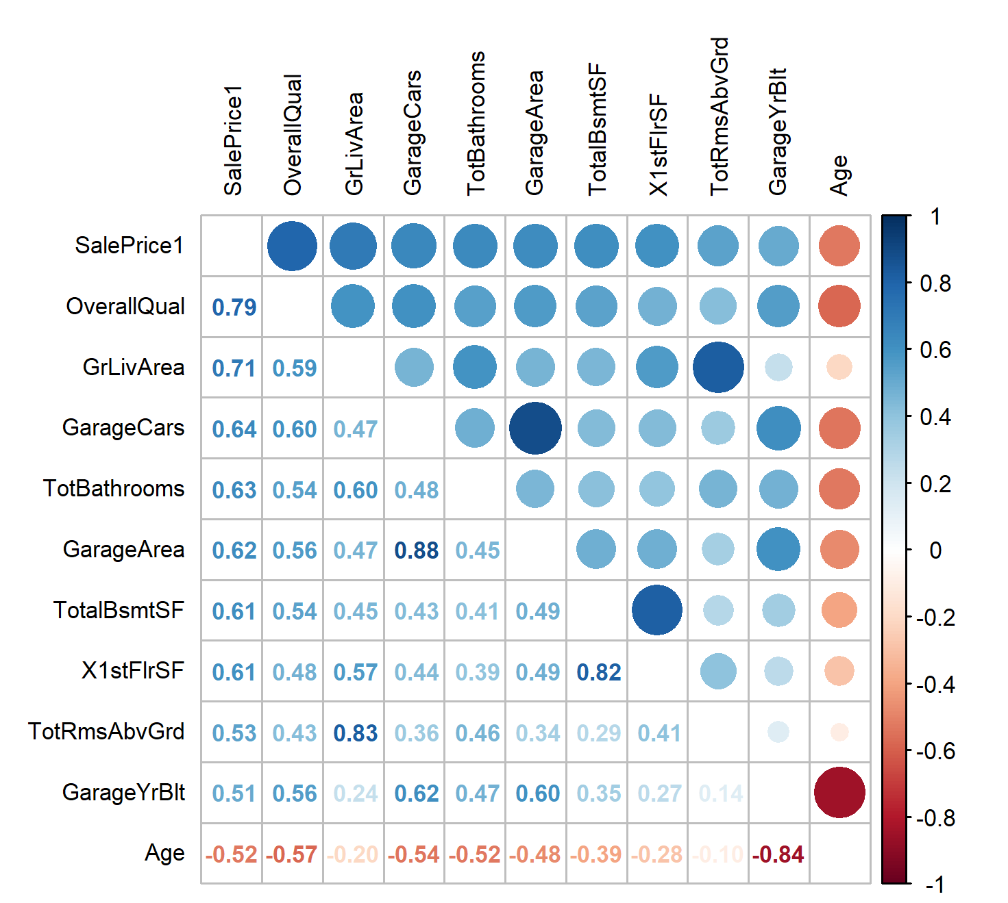
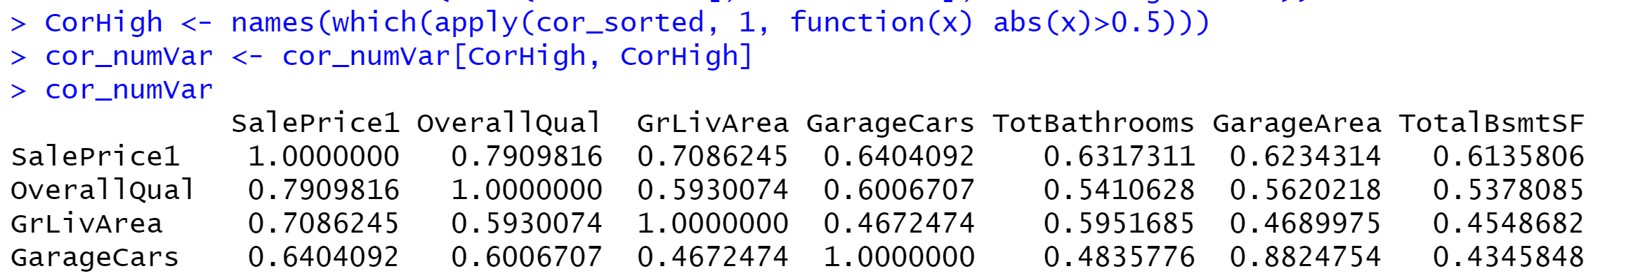
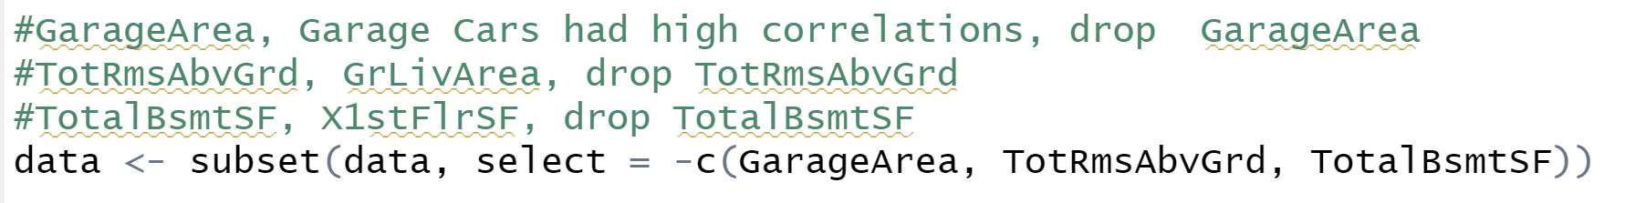
Reproducibility of Solution Code
Do avoid learning spurious correlations
View the cor matrix to check the correlation; drop the unnecessary variables

Slide 10
Reproducibility of Solution Code
RMSE competition
Ridge: 28493.65
Lasso: 34163.63
Bagging:24779.01
Boosted: 23901.98 ------- BEST!!!!
XGBoost: 24301

Slide 11
Citations Citations
Lones, M. A. (2021). How to avoid machine learning pitfalls: a guide for academic researchers. arXiv preprint arXiv:2108.02497
https://developers.google.com/machine-learning/guides/rules-of-ml
.

